Slide 1
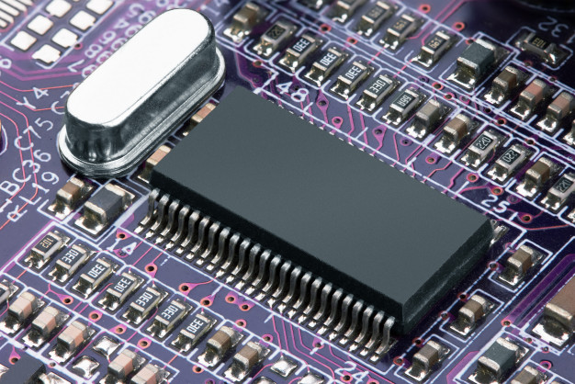

Approaches to Information Gathering & Prototyping
CS456: Advanced System Analysis & Design
Session 3
Ferdinand Hiagbe

Slide 2


Objectives of this lesson
Recognize the value of interactive methods for information gathering
Construct interview questions to elicit human information requirements and structure them in a way that is meaningful to users
Understand the purpose of stories and why they are useful in systems analysis
Understand the concept of J A D and when to use it
Write effective questions to survey users about their work
Design and administer effective questionnaires
Understand the roots of agile modeling in prototyping and the four main types of prototyping

Slide 3
Interactive Methods to Elicit Human Information Requirements
Interviewing
Joint Application Design (J A D)
Questionnaires

Slide 4
Interviewing
Section 1/3

Slide 5
Interviewing
Interviewing is an important method for collecting data on human and system information requirements
Interviews reveal information about:
Interviewee opinions
Interviewee feelings
Goals
Key HCI concerns

Slide 6
Interview Preparation
Reading background material
Establishing interview objectives
Deciding whom to interview
Preparing the interviewee
Deciding on question types and structure

Slide 7
Question Types (1 of 2)
Open-ended
Closed

Slide 8
Figure 4.2 Open-Ended Interview Questions
What’s your opinion of the current state of business-to-business ecommerce in your firm?
What are the critical objectives of your department?
Once the data are submitted via the website, how are they processed?
Describe the monitoring process that is available online.
What are some of the common data entry errors made in this department?
What are the biggest frustrations you’ve experienced during the transition to ecommerce?

Slide 9
Advantages of Open-Ended Questions (1 of 2)
Puts the interviewee at ease
Allows the interviewer to pick up on the interviewee’s vocabulary
Provides richness of detail
Reveals avenues of further questioning that may have gone untapped

Slide 10
Advantages of Open-Ended Questions (2 of 2)
Provides more interest for the interviewee
Allows more spontaneity
Makes phrasing easier for the interviewer
Useful if the interviewer is unprepared

Slide 11
Disadvantages of Open-Ended Questions
May result in too much irrelevant detail
Possibly losing control of the interview
May take too much time for the amount of useful information gained
Potentially seeming that the interviewer is unprepared
Possibly giving the impression that the interviewer is on a “fishing expedition”

Slide 12
Closed Interview Questions
Closed interview questions limit the number of possible responses
Closed interview questions are appropriate for generating precise, reliable data that is easy to analyze
The methodology is efficient, and it requires little skill for interviewers to administer

Slide 13
Figure 4.3 Closed Interview Questions
How many times a week is the project repository updated?
On average, how many calls does the call center receive monthly?
Which of the following sources of information is most valuable to you?
Completed customer complaint forms
Email complaints from consumers who visit the website
Face-to-face interaction with customers
Returned merchandise
List your top two priorities for improving the technology infrastructure.
Who receives this input?

Slide 14
Benefits of Closed Interview Questions
Save interview time
Easily compare interviews
Quickly get to the point
Maintain control of the interview
Cover a large area quickly
Obtain relevant data

Slide 15
Disadvantages of Closed Interview Questions
May be boring for the interviewee
May fail to obtain rich details
May miss some main ideas
May fail to build rapport between interviewer and interviewee

Slide 16
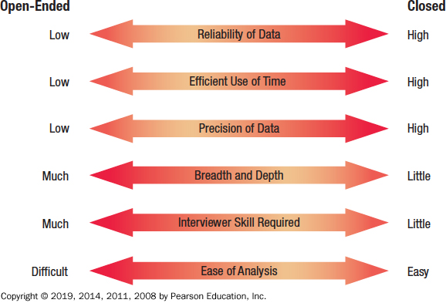
Figure 4.5 Attributes of Open-Ended and Closed Questions

Slide 17
Bipolar Questions
Bipolar questions are those that may be answered with a “yes” or “no” or “agree” or “disagree”
Bipolar questions should be used sparingly
A special kind of closed question

Slide 18
Probes
Probing questions elicit more detail about previous questions
The purpose of probing questions is:
To get more meaning
To clarify
To draw out and expand on the interviewee’s point
May be either open-ended or closed

Slide 19
Arranging Questions
Pyramid
Starting with closed questions and working toward open-ended questions
Funnel
Starting with open-ended questions and working toward closed questions
Diamond
Starting with closed, moving toward open-ended, and ending with closed questions

Slide 20
Pyramid Structure
Begins with very detailed, often closed questions
Expands by allowing open-ended questions and more generalized responses
Is useful if interviewees need to be warmed up to the topic or seem reluctant to address the topic

Slide 21
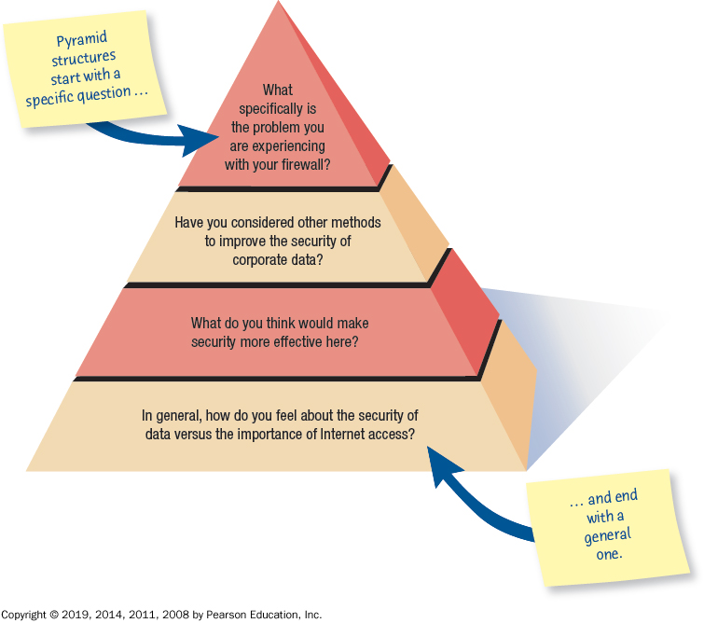
Figure 4.7 Pyramid Structure for Interviewing Goes from Specific to General Questions

Slide 22
Funnel Structure
Begins with generalized, open-ended questions
Concludes by narrowing the possible responses using closed questions
Provides an easy, nonthreatening way to begin an interview
Is useful when the interviewee feels emotionally about the topic

Slide 23
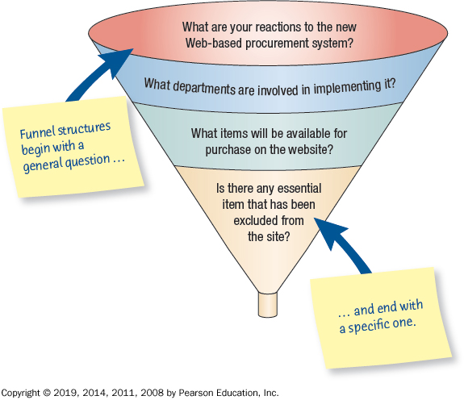
Figure 4.8 Funnel Structure for Interviewing Begins with Broad Questions Then Funnels to Specific Questions

Slide 24
Diamond Structure
A diamond-shaped structure begins in a very specific way
Then more general issues are examined
Concludes with specific questions
Combines the strength of both the pyramid and funnel structures
Takes longer than the other structures

Slide 25
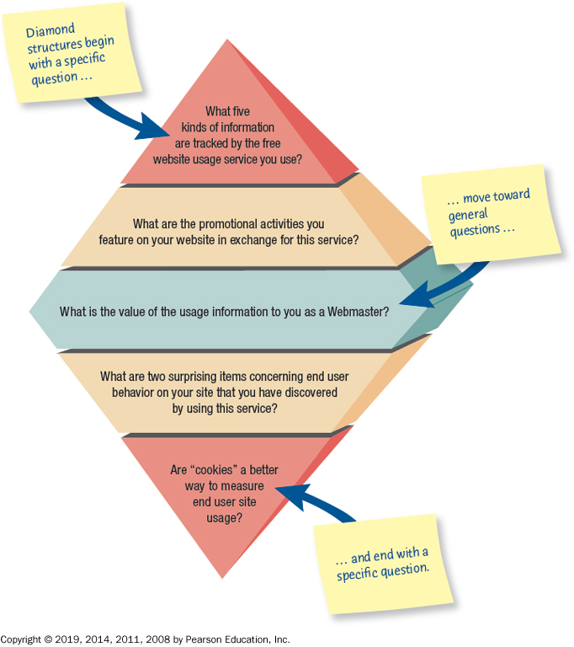
Figure 4.9 Diamond-Shaped Structure for Interviewing Combines the Pyramid and Funnel Structures

Slide 26
Closing the Interview
Always ask “Is there anything else that you would like to add?”
Summarize and provide feedback on your impressions
Ask whom you should talk with next
Set up any future appointments
Thank them for their time and shake hands.

Slide 27
Interview Report
Write as soon as possible after the interview
Provide an initial summary, then more detail
Review the report with the respondent

Slide 28
Joint Application Design (J A D)
Section 1/3

Slide 29
Joint Application Design (J A D)
Joint Application Design (J A D) can replace a series of interviews with the user community
J A D is a technique that allows the analyst to accomplish requirements analysis and design the user interface with the users in a group setting

Slide 30
Conditions That Support the Use of J A D
Users are restless and want something new
The organizational culture supports joint problem-solving behaviors
Analysts forecast an increase in the number of ideas using J A D
Personnel may be absent from their jobs for the length of time required

Slide 31
Who is Involved
The people involved are:
Executive sponsor
IS analyst
Users
Session leader
Observers
Scribe

Slide 32
Where to Hold J A D Meetings
Offsite
Comfortable surroundings
Minimize distractions
Attendance
Schedule when participants can attend
Agenda
Orientation meeting

Slide 33
Benefits of J A D
Time is saved, compared with traditional interviewing
Rapid development of systems
Improved user ownership of the system
Creative idea production is improved

Slide 34
Drawbacks of Using J A D
J A D requires a large block of time to be available for all session participants
If preparation or the follow-up report is incomplete, the session may not be successful
The organizational skills and culture may not be conducive to a J A D session

Slide 35
Questionaries
Section 1/3

Slide 36
Questionnaires
Questionnaires are useful in gathering information from key organization members about:
Attitudes
Beliefs
Behaviors
Characteristics

Slide 37
Planning for the Use of Questionnaires
Organization members are widely dispersed
Many members are involved with the project
Exploratory work is needed
Problem solving prior to interviews is necessary

Slide 38
Question Types (2 of 2)
Questions are designed as either:
Open-ended
Try to anticipate the response you will get
Well suited for getting opinions
Closed
Use when all the options may be listed
When the options are mutually exclusive

Slide 39
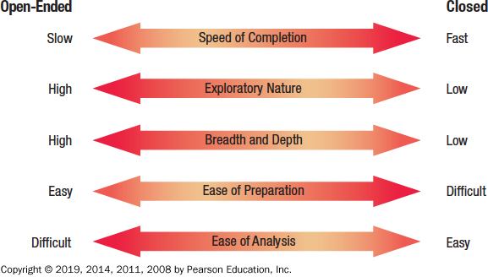
Figure 4.13 Trade-Offs between the Use of Open-Ended and Closed Questions on Questionnaires

Slide 40
Questionnaire Language
Simple
Specific
Short
Not patronizing
Free of bias
Addressed to those who are knowledgeable
Technically accurate
Appropriate for the reading level of the respondent

Slide 41
Measurement Scales
The two different forms of measurement scales are:
Nominal
Interval

Slide 42
Nominal Scales
Nominal scales are used to classify things
It is the weakest form of measurement
Data may be totaled
What type of software do you use the most?
1 = Word Processor
2 = Spreadsheet
3 = Database
4 = An Email Program

Slide 43
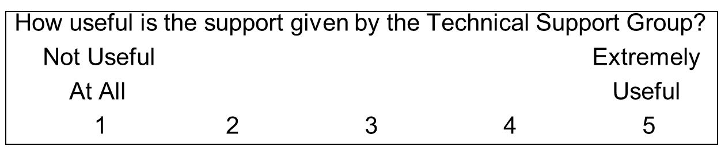
Interval Scales
An interval scale is used when the intervals are equal
There is no absolute zero
Examples of interval scales include the Fahrenheit or Centigrade scale

Slide 44
Validity and Reliability
Reliability of scales refers to consistency in response—getting the same results if the same questionnaire was administered again under the same conditions
Validity is the degree to which the question measures what the analyst intends to measure
Cronbach’s Alpha

Slide 45
Problems with Scales
Leniency
Central tendency
Halo effect

Slide 46
Leniency
Caused by easy raters
Solution is to move the “average” category to the left or right of center

Slide 47
Halo Effect
When the impression formed in one question carries into the next question
Solution is to place one trait and several items on each page

Slide 48
Designing the Questionnaire
Allow ample white space
Allow ample space to write or type in responses
Make it easy for respondents to clearly mark their answers
Be consistent in style

Slide 49
Order of Questions
Place most important questions first
Cluster items of similar content together
Introduce less controversial questions first

Slide 50
Administering Questionnaires
Administering questionnaires has two main questions:
Who in the organization should receive the questionnaire
How should the questionnaire be administered

Slide 51
Figure 4.14 Ways to Capture Responses When Designing a Web Survey
Name | Appearance | Purpose
One-line text box | A single line text box is shown, Used to obtain a small amount of text and limit the answer to a few words. | Used to obtain a small amount of text and limit the answer to a few words
Scrolling text box | Multi line text box with horizontal and vertical scroll bars shown, Used to obtain one or more paragraphs of text. | Used to obtain one or more paragraphs of text
Check box | Checkbox is shown, Used to obtain a yes-no answer left parenthesis example, Do you wish to be included on the mailing list? Right parenthesis. | Used to obtain a yes-no answer (e.g., Do you wish to be included on the mailing list?)
Radio button | Checked radio button, a round button with a solid dot in the center, is shown : Used to obtain a yes-no or true-false answer. | Used to obtain a yes-no or true-false answer
Drop-down menu | Image of a dropdown button is shown : Used to obtain more consistent results Left parenthesis Respondent is able to choose the appropriate answer from a predetermined list left bracket example., a list of state abbreviations right bracket right parenthesis. | Used to obtain more consistent results (Respondent is able to choose the appropriate answer from a predetermined list [e.g., a list of state abbreviations])
Push button | Push button, Image of a button labeled as Button is shown, Most often used for an action left parenthesis e.g., a respondent pushes a button marked “Submit” or “Clear” right parenthesis. | Most often used for an action (e.g., a respondent pushes a button marked “Submit” or “Clear”)

Slide 52
Electronically Submitting Questionnaires
Reduced costs
Collecting and storing the results electronically

Slide 53
Prototyping
Section 1/3

Slide 54
Agile Modeling, but First Prototyping
Agile modeling is a collection of innovative, user-centered approaches to system development
Prototyping is an information-gathering technique useful in seeking
User reactions
Suggestions
Innovations
Revision plans

Slide 55
Prototyping
Patched-up
Nonoperational
First-of-a-series
Selected features

Slide 56
Patched-Up Prototype
A system that works but is patched up or patched together
A working model that has all the features but is inefficient
Users can interact with the system
Retrieval and storage of information may be inefficient

Slide 57
Nonoperational Scale Models
A nonworking scale mode that is set up to test certain aspects of the design
A nonworking scale model of an information system might be produced when the coding required by the application is too expensive to prototype but when a useful idea of the system can be gained through prototyping of the input and output only

Slide 58
First-Of-A-Series Prototype
Creating a pilot
Prototype is completely operational
Useful when many installations of the same information system are planned
A full-scale prototype is installed in one or two locations first, and if successful, duplicates are installed at all locations based on customer usage patterns and other key factors

Slide 59
Selected Features Prototype
Building an operational model that includes some, but not all, of the features that the final system will have
Some, but not all, essential features are included
Built in modules
Part of the actual system

Slide 60
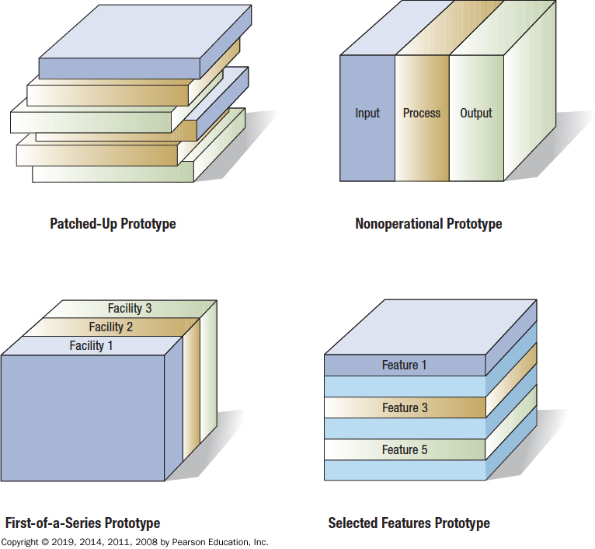
Figure 6.1 Four Kinds of Prototypes

Slide 61
Users’ Role in Prototyping
Honest involvement
Communicate the purpose of the prototype clearly
Get suggestions for changing, expanding the prototype and innovation

Slide 62
Q&A
Ferdinand Hiagbe

